Slide 1
Long Short equity
July 2015

Slide 2
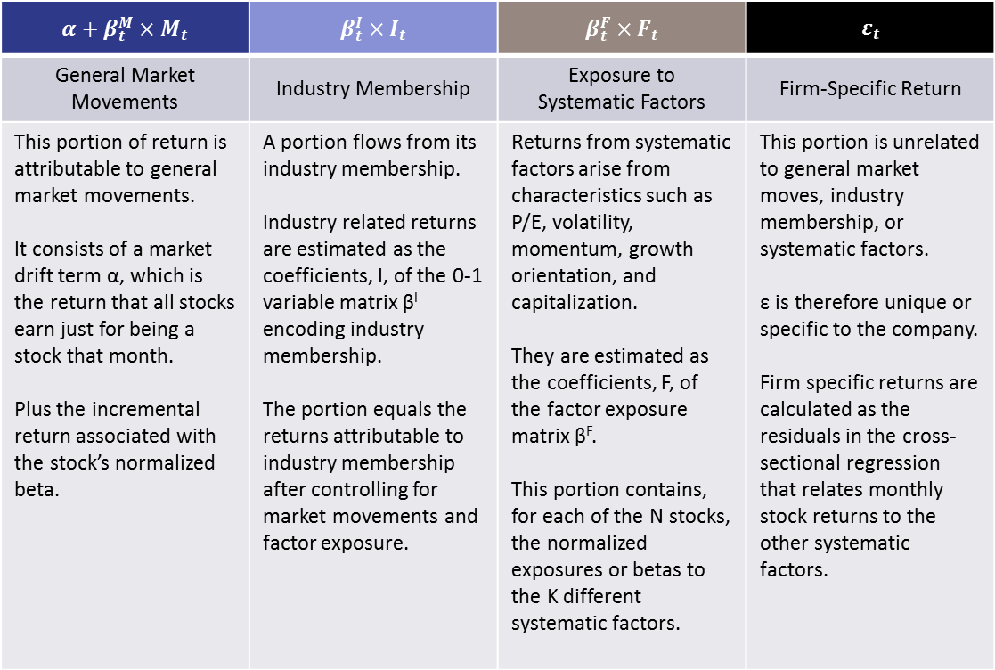
Return Generating process for equity
There are some fundamental differences between modeling credit events for residential loans versus commercial loans.
The smaller population of commercial mortgages, heterogeneity of the underlying properties/loans, and the potential for large single loans to have an outsized impact on the returns of a securitization (“concentration risk”) all lead to a modeling process that combines qualitative and quantitative measures.
4 Components of Returns
$$R_{t} = α+β_{t}^{M}×M_{t} + β_{t}^{I}×I_{t} + β_{t}^{F}×F_{t} + ε_{t}$$
$$α+β_{t}^{M}×M_{t}$$ | $$β_{t}^{I}×I_{t}$$ | $$β_{t}^{F}×F_{t}$$ | $$ε_{t}$$
General Market Movements | Industry Membership | Exposure to Systematic Factors | Firm-Specific Return
This portion of return is attributable to general market movements. It consists of a market drift term α, which is the return that all stocks earn just for being a stock that month. Plus the incremental return associated with the stock’s normalized beta. | A portion flows from its industry membership. Industry related returns are estimated as the coefficients, I, of the 0-1 variable matrix β^{I} encoding industry membership. The portion equals the returns attributable to industry membership after controlling for market movements and factor exposure. | Returns from systematic factors arise from characteristics such as P/E, volatility, momentum, growth orientation, and capitalization. They are estimated as the coefficients, F, of the factor exposure matrix β^{F}. This portion contains, for each of the N stocks, the normalized exposures or betas to the K different systematic factors. | This portion is unrelated to general market moves, industry membership, or systematic factors. ε is therefore unique or specific to the company. Firm specific returns are calculated as the residuals in the cross-sectional regression that relates monthly stock returns to the other systematic factors.
Source: Blackrock, Cello

Slide 3

Investment Style
There are some fundamental differences between modeling credit events for residential loans versus commercial loans.
The smaller population of commercial mortgages, heterogeneity of the underlying properties/loans, and the potential for large single loans to have an outsized impact on the returns of a securitization (“concentration risk”) all lead to a modeling process that combines qualitative and quantitative measures.
Style Factors
Investment Style | Investor-focused
Equity Valuation | Bottoms-up Fundamental Analysis
Holding Period | 3-6 Months
Investment
Style
Identifying
Opportunities
Investment Opportunities Identification
Analysis Techniques | Discount Market Inefficiencies
Opportunities Identification Process
Catalysts
Identify a Theme
Exploit the Theme
Deep-Dive Targets
Source: Blackrock, Cello

Slide 4
Portfolio Construction
There are some fundamental differences between modeling credit events for residential loans versus commercial loans.
The smaller population of commercial mortgages, heterogeneity of the underlying properties/loans, and the potential for large single loans to have an outsized impact on the returns of a securitization (“concentration risk”) all lead to a modeling process that combines qualitative and quantitative measures.
Initialize Positions
Position Size
Intention
Small, toe-hold position | Building the position as conviction grows and/or catalysts unfold
Midsize position | Less upside relative to other positions Same intent as toe-hold positions
Maximum position | Potentially with a near-term catalyst
Change Position Size
Process
Activity
Risk/Reward Assessment | Review the risk/reward profile of current position. As positions move closer to their price target, they are viewed as more risky as the potential for give-back of open profit is increase.
Active Rebalancing | Trim from positions reach predetermined size constraints; Redeploy the capital to other attractive equities.
Catalyst Analysis | Capture the specific “event” from economic scenarios that leads to the stock converging towards its price target.
Sell Discipline
Exit Trigger
Methodology
Price Targets | Once price targets have been hit, position is usually closed out. A portion may be kept for extra profit from market momentum.
Better Opportunities | Better investment opportunities occur.
Establishing and Checking New Thesis | When a position doesn’t move in-line with expectations, the thesis is re-evaluated. If it’s no longer hold, exits will occur.
Macro Factors | Uncertainty surrounding government interventions.
Source: Blackrock, Cello

Slide 5
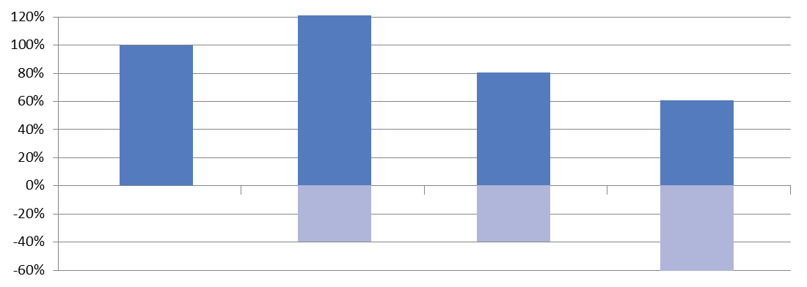
Strategy categorization
Market Dependent
Core
There are some fundamental differences between modeling credit events for residential loans versus commercial loans.
The smaller population of commercial mortgages, heterogeneity of the underlying properties/loans, and the potential for large single loans to have an outsized impact on the returns of a securitization (“concentration risk”) all lead to a modeling process that combines qualitative and quantitative measures.
High Beta
≥100%
Long-biased
No dedicated short book
Alpha as oppose to hedge
their long book
Flexible/Directional
70-100%
Long biased
Consistently manage short books
Generate flexibility to
the market movements
Market Exposure
Positions
Purpose of Short
Low Beta
0-30%
Remain market neutral
Generate market neutral
by dollar/beta adjusted
Hedged
30-70%
Maintain short book at all times
As a profit centre
Hedging
Market Exposure
Positions
Purpose of Short
Source: Blackrock, Cello

Slide 7
Strategy categorization
Low Beta is a market dependent strategy. Managers in this strategy category are generally market neutral either on a dollar value (dollars on the long side equal dollars on the short side) or beta adjusted (beta on the long side matches beta on the short side) basis.
Low Beta Strategy
With Highest Market Exposure
Max Market Exposure: 30%
Gross Invested: 110%
Low Beta Strategy
With Lowest Market Exposure
Min Market Exposure: 0%
Gross Invested: 120%
70%
Gross Long
60%
Gross Long
Max: 30%
Market Exposure
Min: 0%
Market Exposure
40%
Gross Short
60%
Gross Short
Source: Blackrock, Cello

Slide 8
Low Beta Strategy
With Highest Market Exposure
Max Market Exposure: 30%
Gross Invested: 110%
Low Beta Strategy
With Lowest Market Exposure
Min Market Exposure: 0%
Gross Invested: 120%
70%
Gross Long
60%
Gross Long
Max: 30%
Market Exposure
Min: 0%
Market Exposure
40%
Gross Short
60%
Gross Short

